Slide 1
Machine Learning
House Price Prediction

Slide 2
Outline
EDA
Sale Price Analysis(descriptive Summary)
Numerical Feature
Catagorical Feature

Slide 3
Sale Price Analysis Descriptive Summary
,

Slide 4
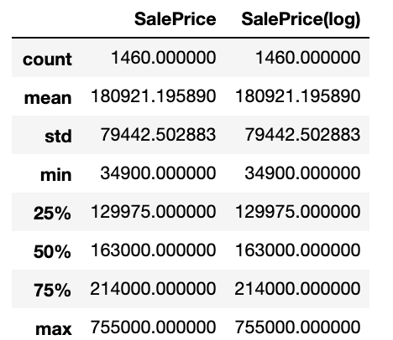
Sale Price Analysis Descriptive Summary
.

Slide 5
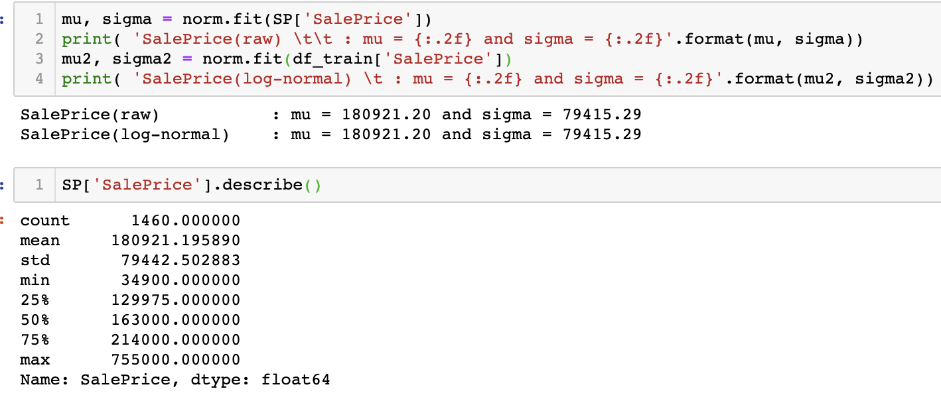
Histogram and Distribution
.

Slide 6
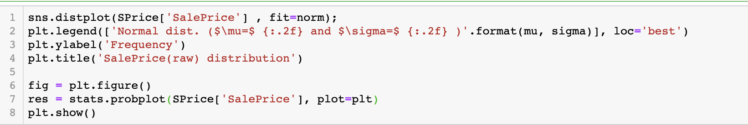
Histogram and Distribution continue..
.

Slide 7
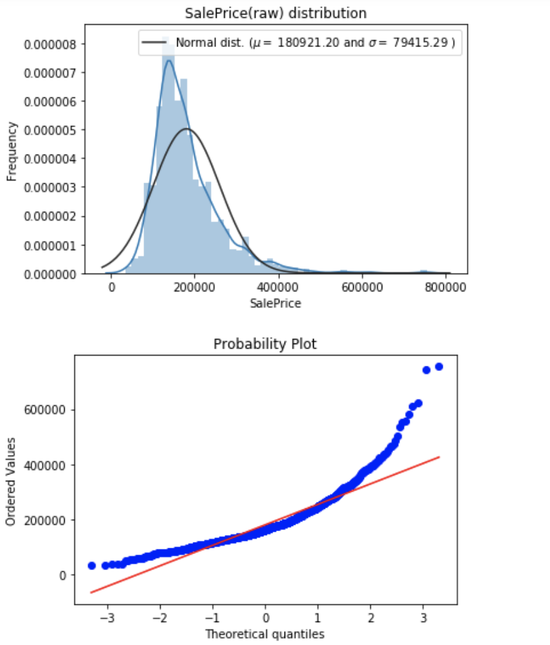
Histogram and Distribution
.

Slide 8
Histogram and Distribution
With this information we can see that the prices are skewed right and some outliers lies above ~500,000. We will eventually want to get rid of the them to get a normal distribution of the independent variable (SalePrice) for machine learning

Slide 9
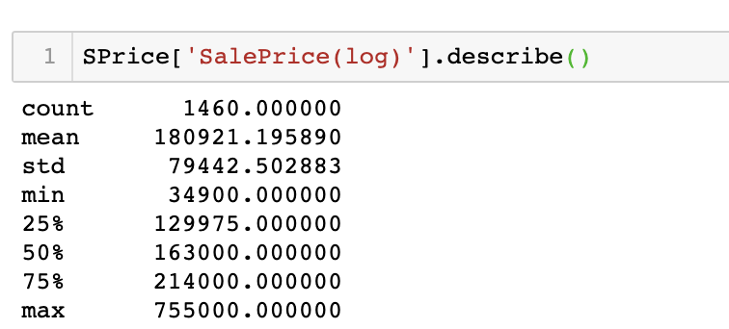
Log normal SalePrice Distribution
.

Slide 10
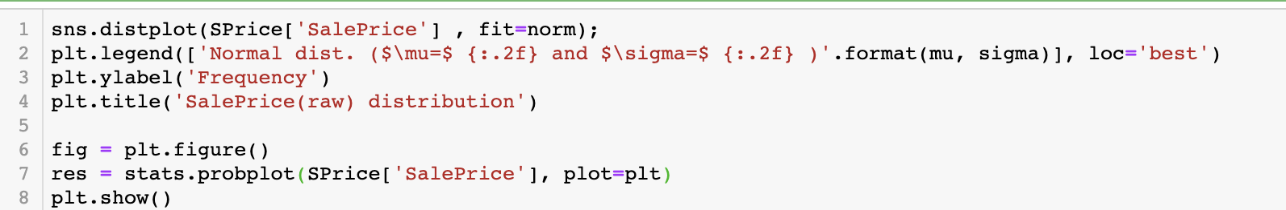
Log normal SalePrice Distribution
.

Slide 11
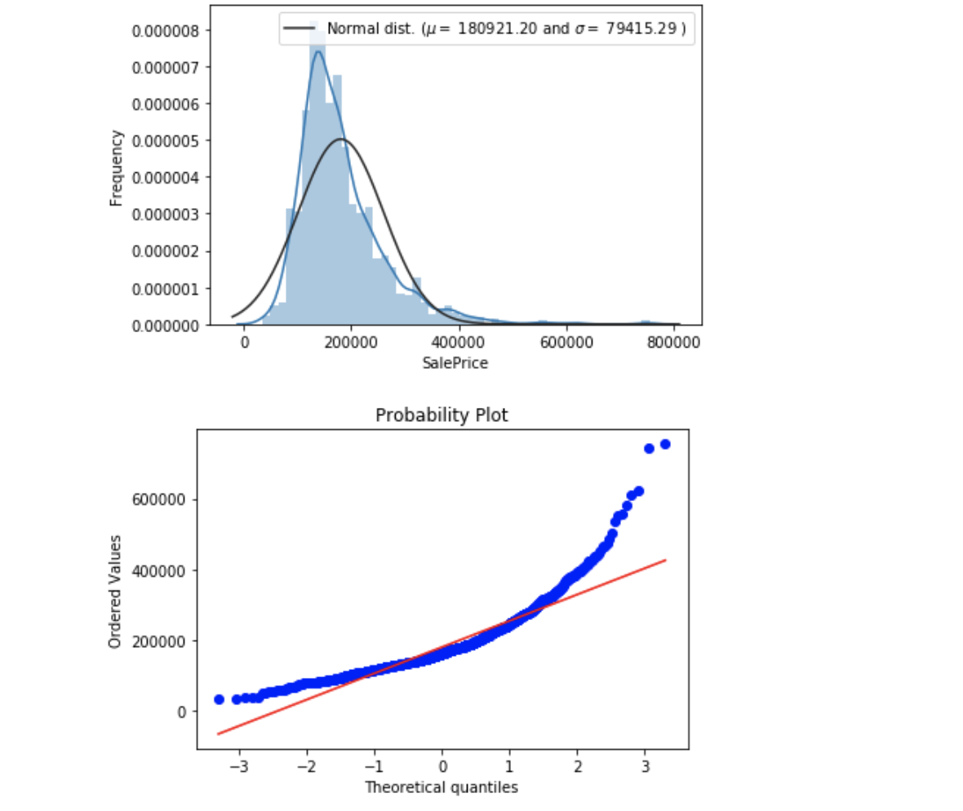
Log normal SalePrice Distribution
.

Slide 12
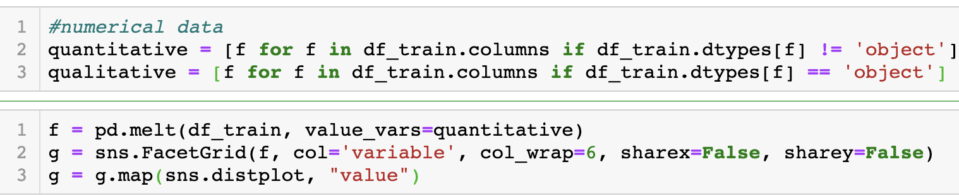
Numerical Data Exploration
.

Slide 13
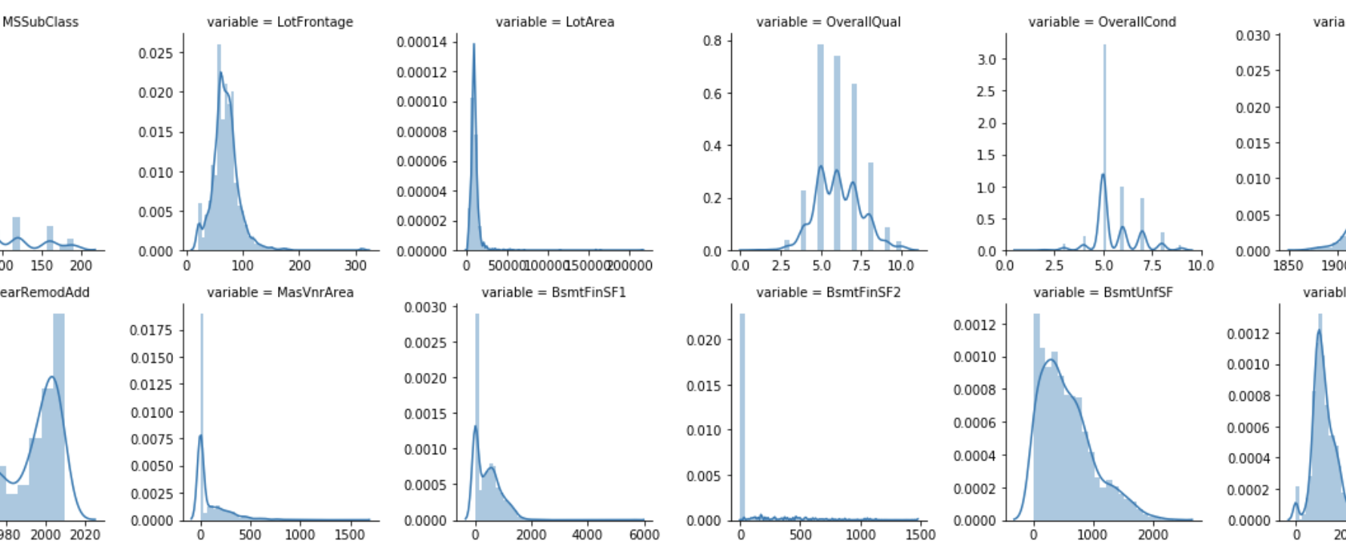
Numerical Data Explore
.

Slide 14
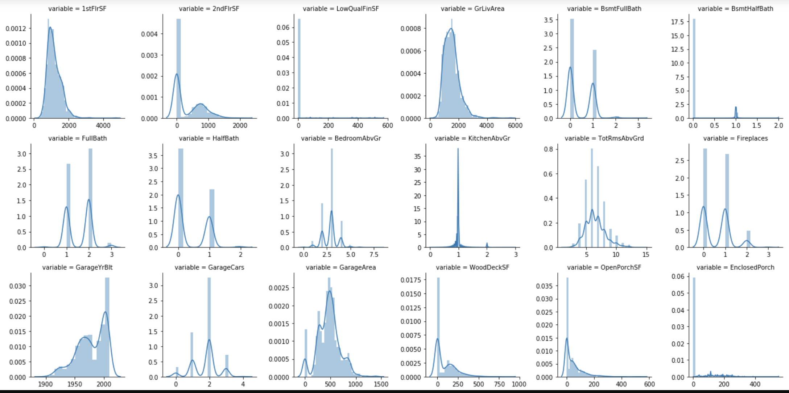
Numerical Data Explore Conti..
.

Slide 15
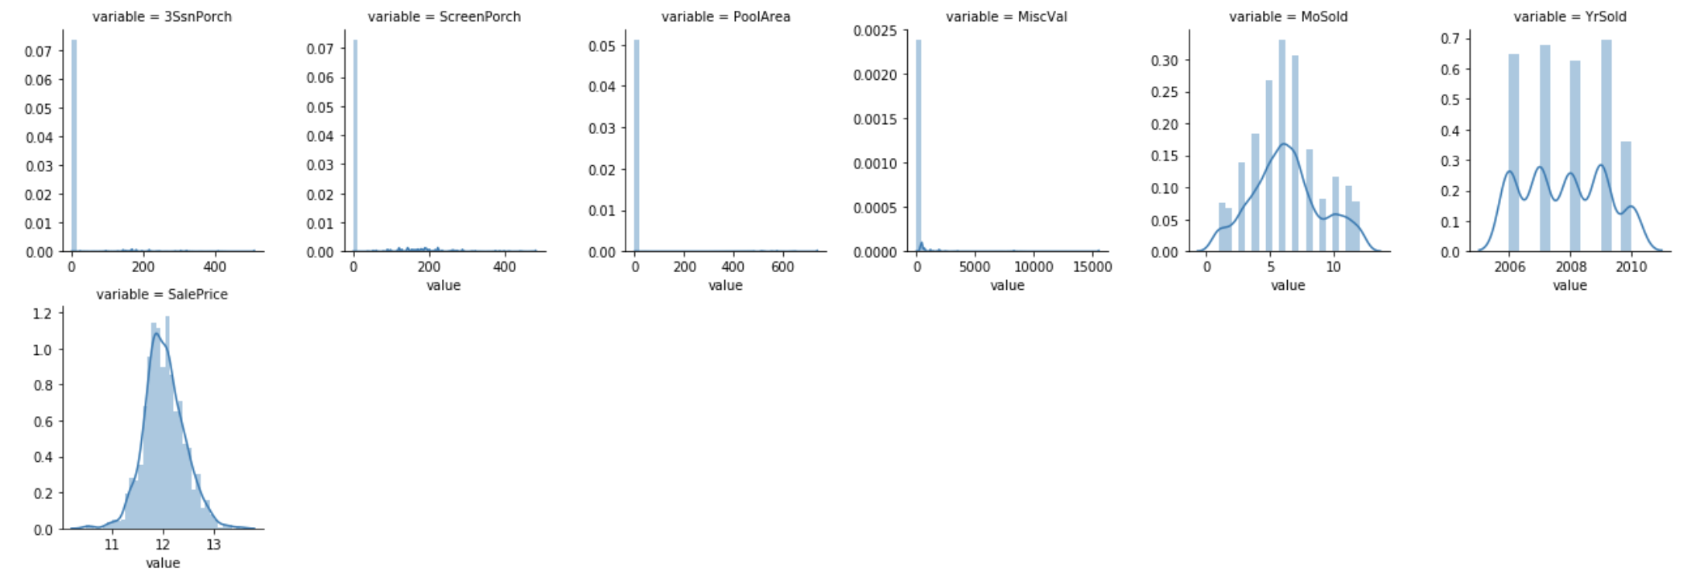
Numerical Data Explore Conti..
.

Slide 16
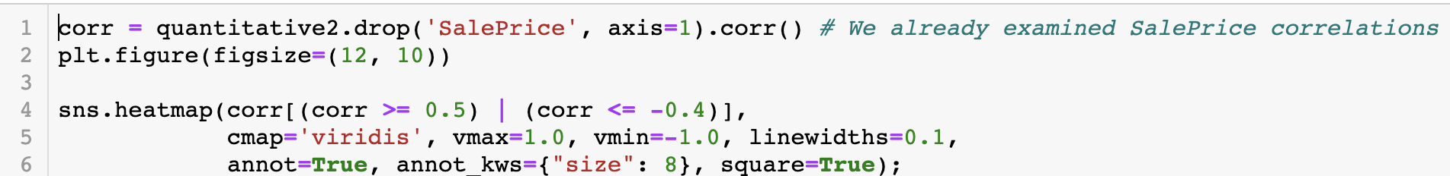
Numerical Data Correlations (Heatmap)
.

Slide 17
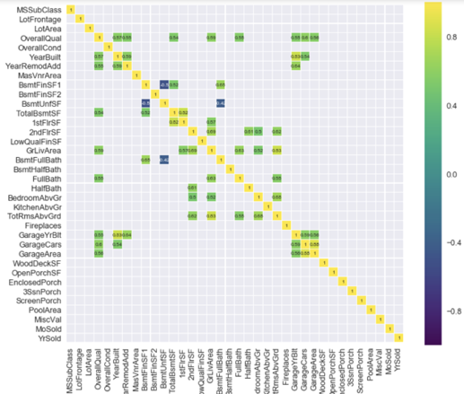
Numerical Data Correlations (Heatmap)
.

Slide 18
Numerical Data Correlations
Corr >= 0.5
1st Floor & Total Basement
Total Rooms Grd & Gr Liv Area
Garage Year Built & Year Built
Garage Area & Garage Cars
corr <= -0.4
Basement Full Bath
Basement Unif

Slide 19
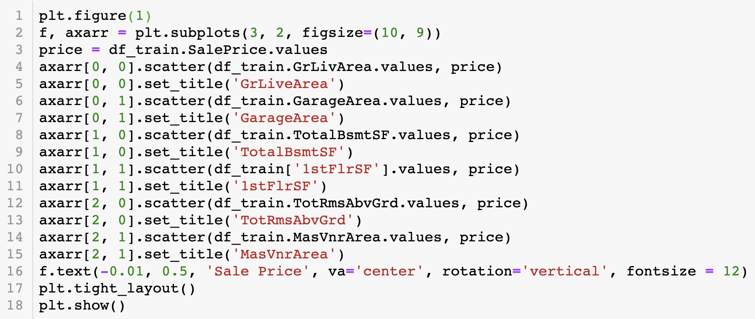
Numerical Data on Sale Price
.

Slide 20
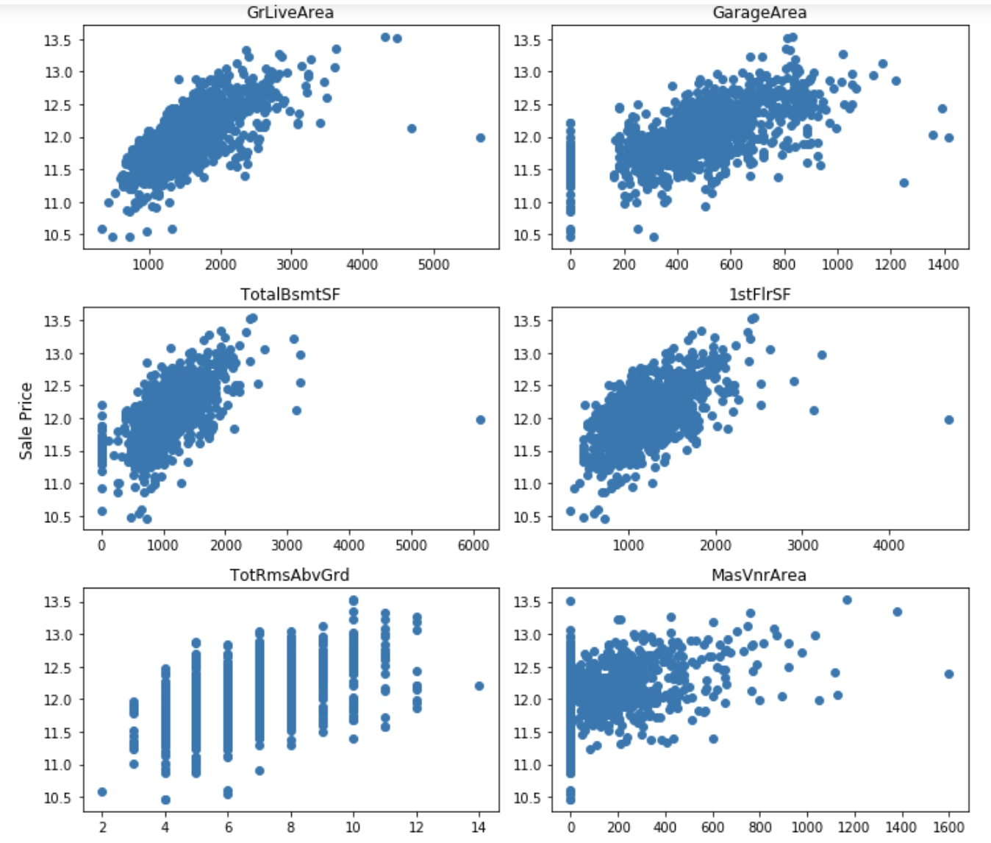
Numerical Data on Sale Price
.

Slide 21
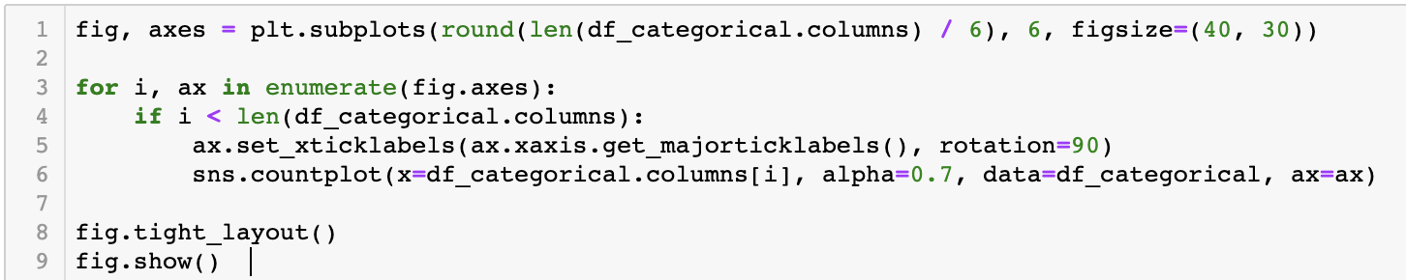
Categorical Data Exploration
.

Slide 22
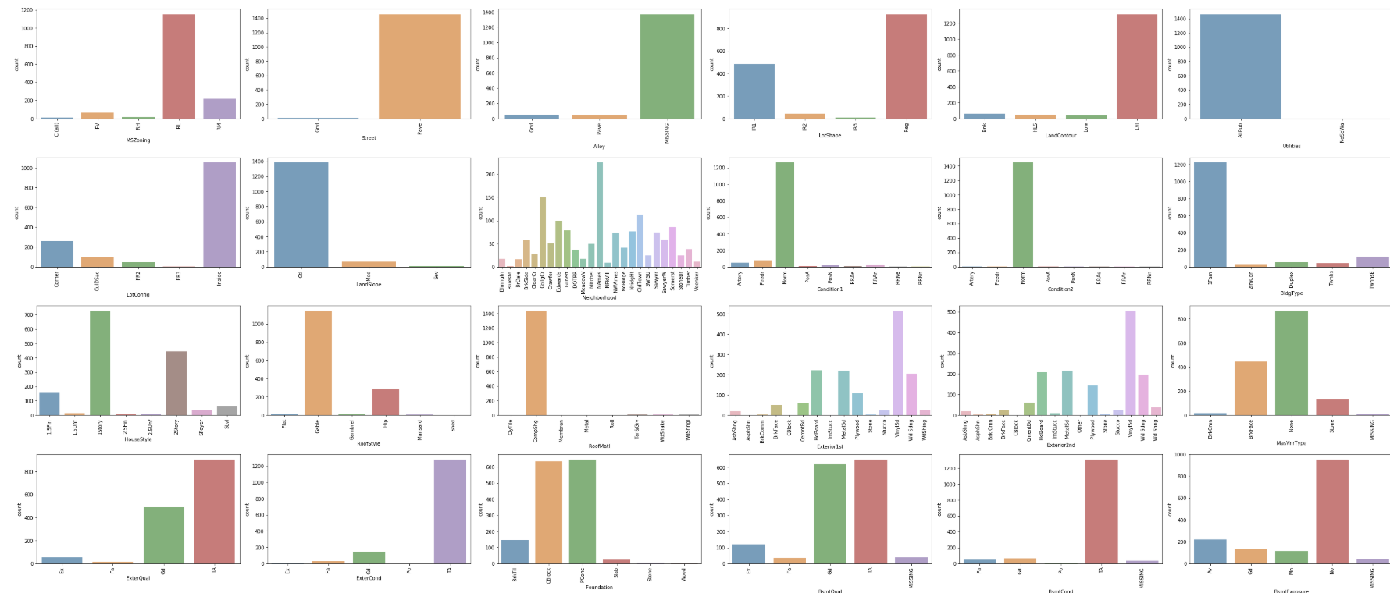
Categorical Data Exploration continue..
.

Slide 23
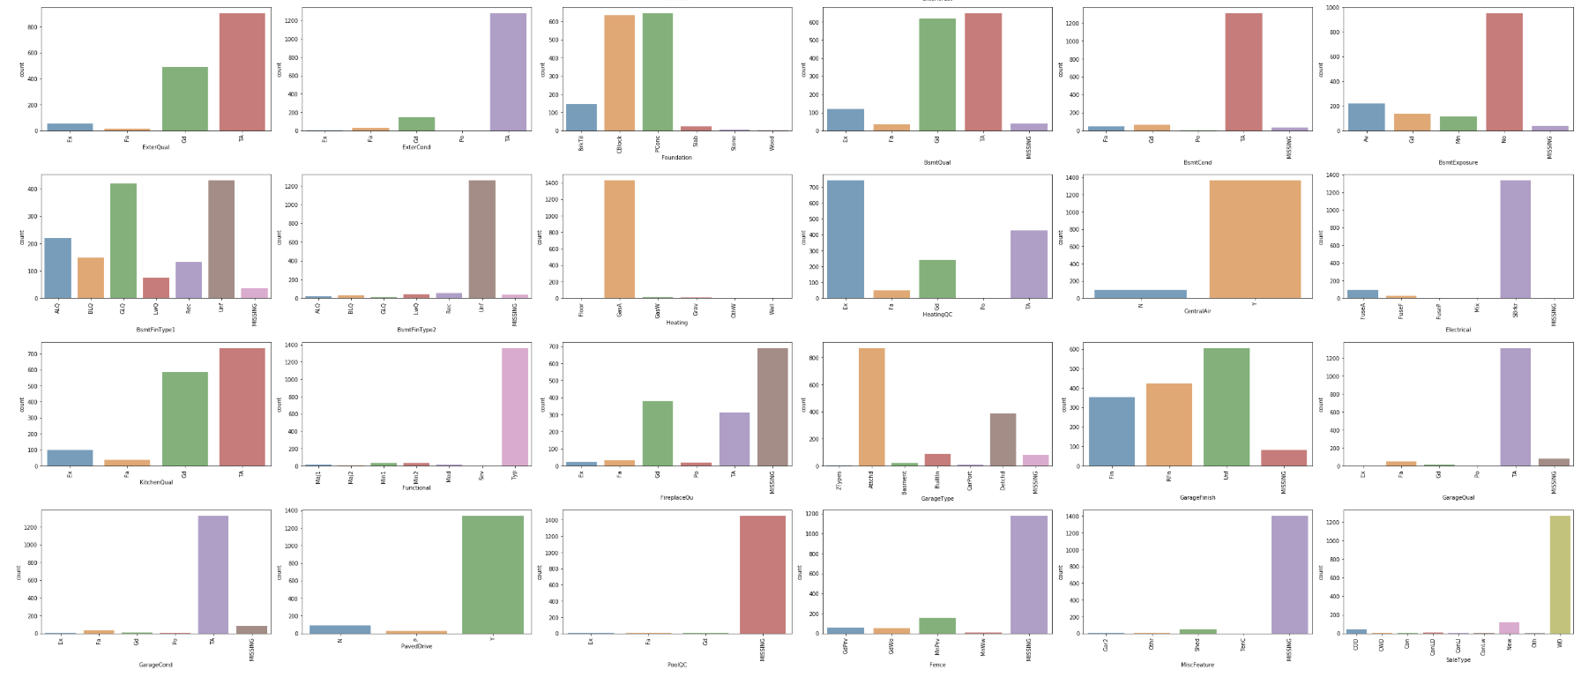
Categorical Data Exploration continue..
.

Slide 24
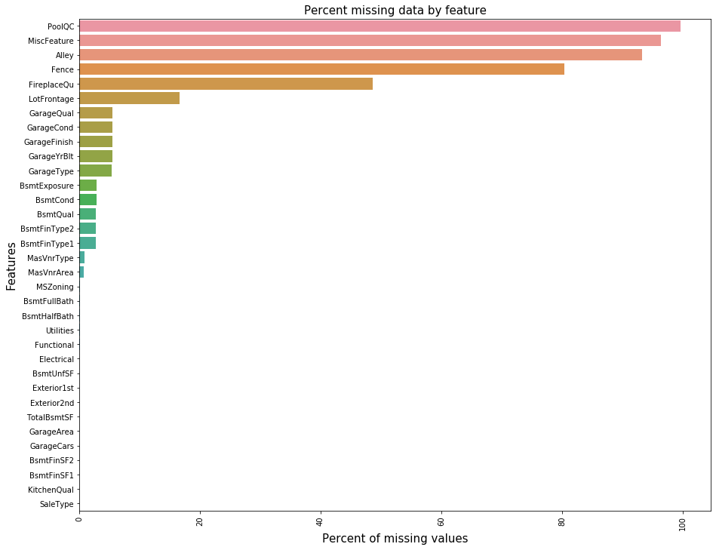
ANALYZE MISSING VALUE
PoolQC | 99.657417
MiscFeature | 96.402878
Alley | 93.216855
Fence | 80.438506
FireplaceQu | 48.646797
LotFrontage | 16.649538
GarageQual | 5.447071
GarageCond | 5.447071
GarageFinish | 5.447071
GarageYrBlt | 5.447071
GarageType | 5.378554
BsmtExposure | 2.809181
BsmtCond | 2.809181
BsmtQual | 2.774923
BsmtFinType2 | 2.740665
BsmtFinType1 | 2.706406

Slide 25
ARE DATA REALY MISSING?
PoolQC
MiscFeature
Alley
Fence
FireplaceQu
GarageQual
GarageCond
GarageFinish
GarageType
NA = Not exist, Refers to “data_description.txt”

Slide 26
IMPUTATION METHODS
Median Imputation For ‘LotFrontage’ due to outlier
Mode Imputation For Categorical Variables
Zero Imputation Logical reasoning

Slide 27
Model Analysis
Prediction Models
Linear Regression
Gradient Boosting
Random Forests

Slide 28
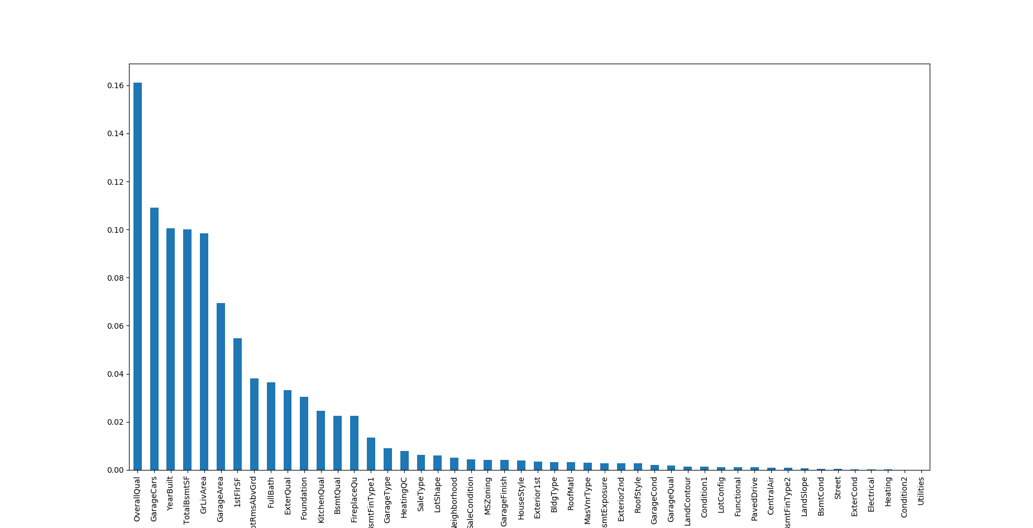
Feature Importance After Modeling

Slide 29
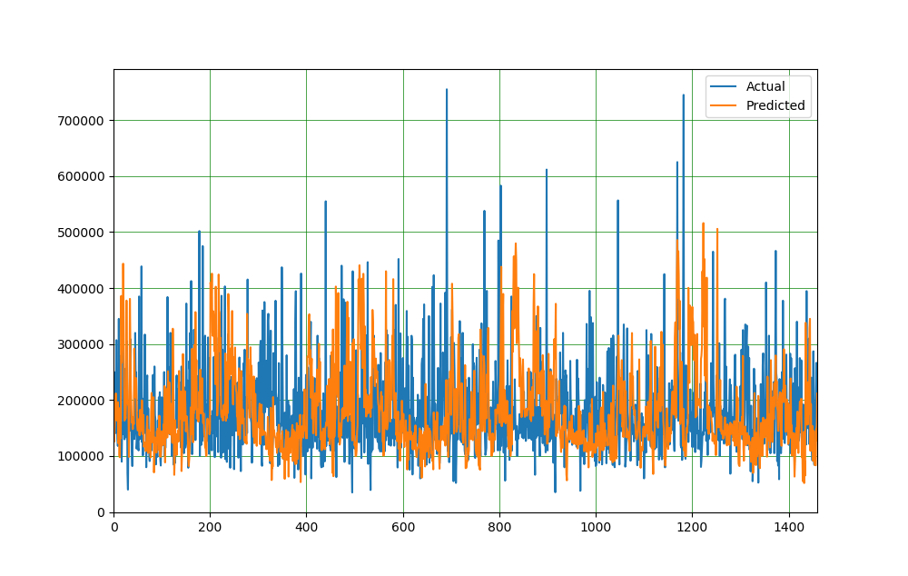
Plotting Training Data Prediction

Slide 30
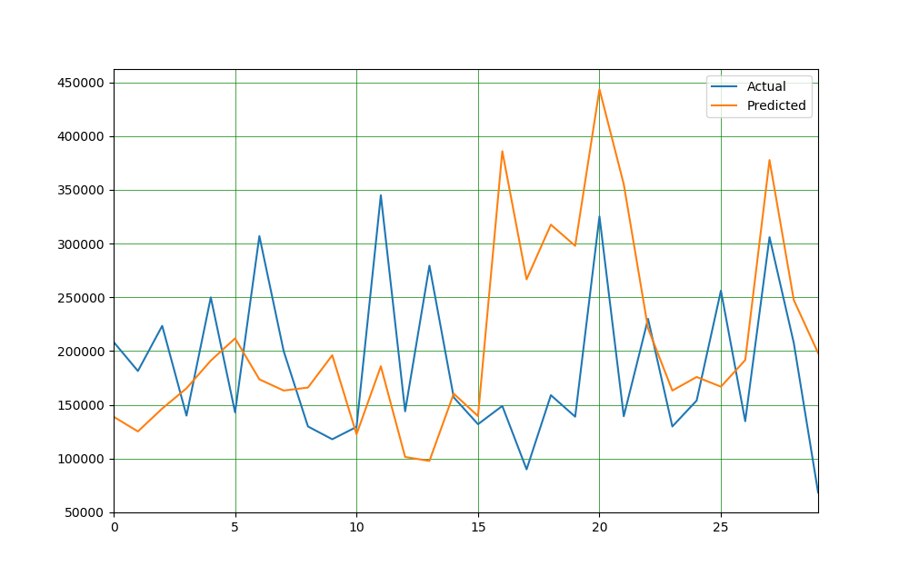

Slide 31
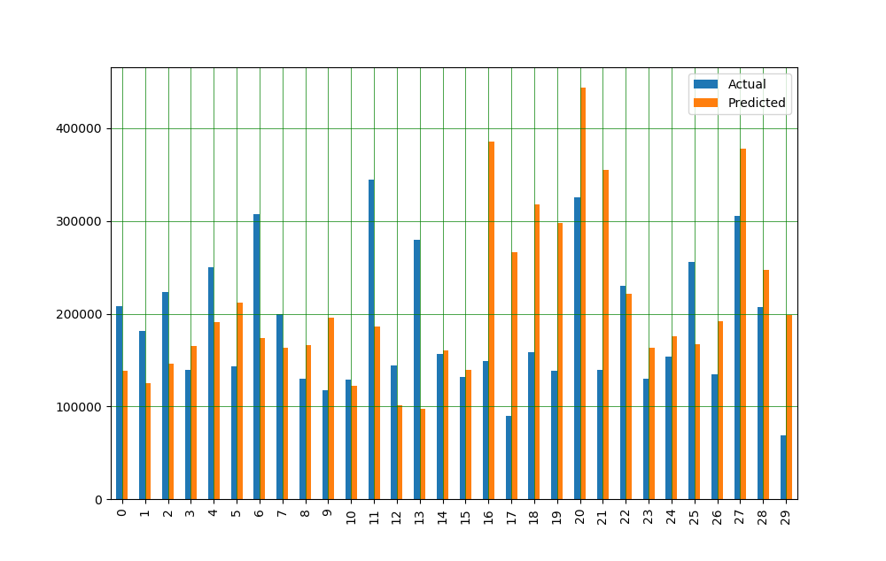

Slide 32
Models Tested
 | train score(R2) | test score
Linear Regression | 0.940049 | 0.940049
Lasso | 0.938488 | 8.306444e-01
Random Forest | 0.976609 | 0.976609

Slide 33
Selected Model Metrics
Random Forest Was Selected For Prediction Among All the Reviewed Models
Mean Absolute Error | 72766.25441891294
Mean Squared Error | 9144001264.357006
Mean Squared Error | 95624.27131412299

